Slide 1
Forces
Forces

Slide 2
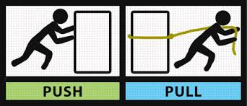
Force
1. A push or pull upon an object resulting from the object’s interaction with another object

Slide 3
Forces
All forces are either:
Contact forces act when objects are physically touching.
Non-contact forces can act when objects are physically separated.

Slide 4

Contact Force
5. Contact forces must be touching or connected to have an effect on an object.

Slide 5
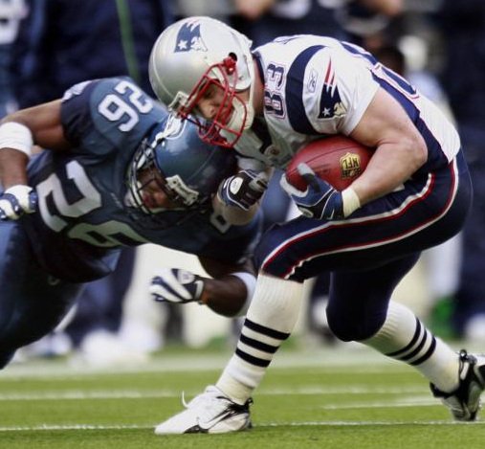
6. Example of Contact Force
http://www.youtube.com/watch?v=2j9ofrTtjHs

Slide 6
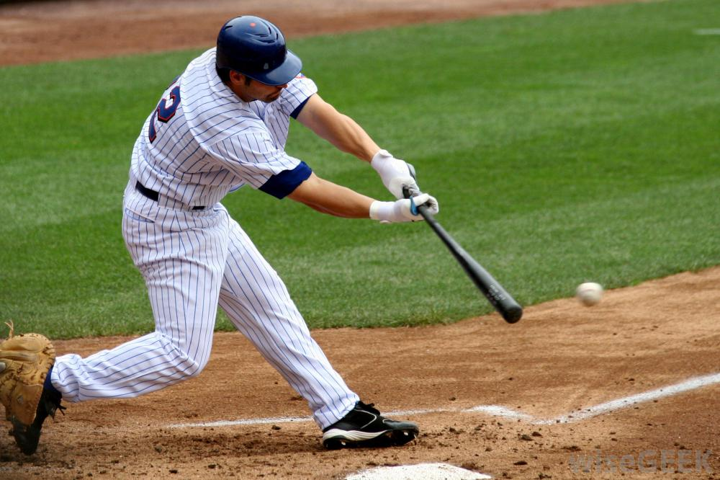
7. Example of Contact Force

Slide 7
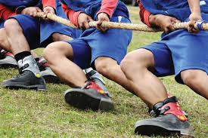
8. Example of Contact Force

Slide 8
9. & 10. Example of Contact Force
Please provide a couple more examples of a contact force on your own.

Slide 9

Contact forces Forces between objects that are physically touching.
Friction
When objects slide over each other they experience frictional forces.
E.g. A car driving along a road or a ball rolling down a slope.
Friction
Friction

Slide 10
Contact forces Forces between objects that are physically touching.
Air resistance
When objects move through the air they experience forces of air resistance.
E.g. A ball falling through the air.
Air resistance

Slide 11
Contact forces Forces between objects that are physically touching.
Tension
When objects are pulled or stretched they experience tension forces.
E.g. A cable lifting a heavy weight.
Tension
1 tonne

Slide 12
Contact forces Forces between objects that are physically touching.
Normal contact force
When objects rest on a surface they experience a normal contact force or reaction force.
E.g. A box resting on a table.
Normal contact force

Slide 13
Non-Contact Force
11. Non-contact forces don’t have to touch to have an effect. They work over a distance or a field of influence.

Slide 14
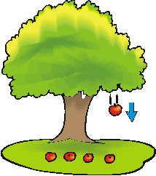
Example of Non-Contact Force
12. Gravity

Slide 15
Non-contact forces Forces between objects that are not physically touching.
Gravitational force
When objects with mass are in a gravitational field they experience a gravitational force.
E.g. The Moon orbits the Earth because there gravitational forces attract each other.
Moon
Earth

Slide 16

13. Example of Non-Contact Force

Slide 17
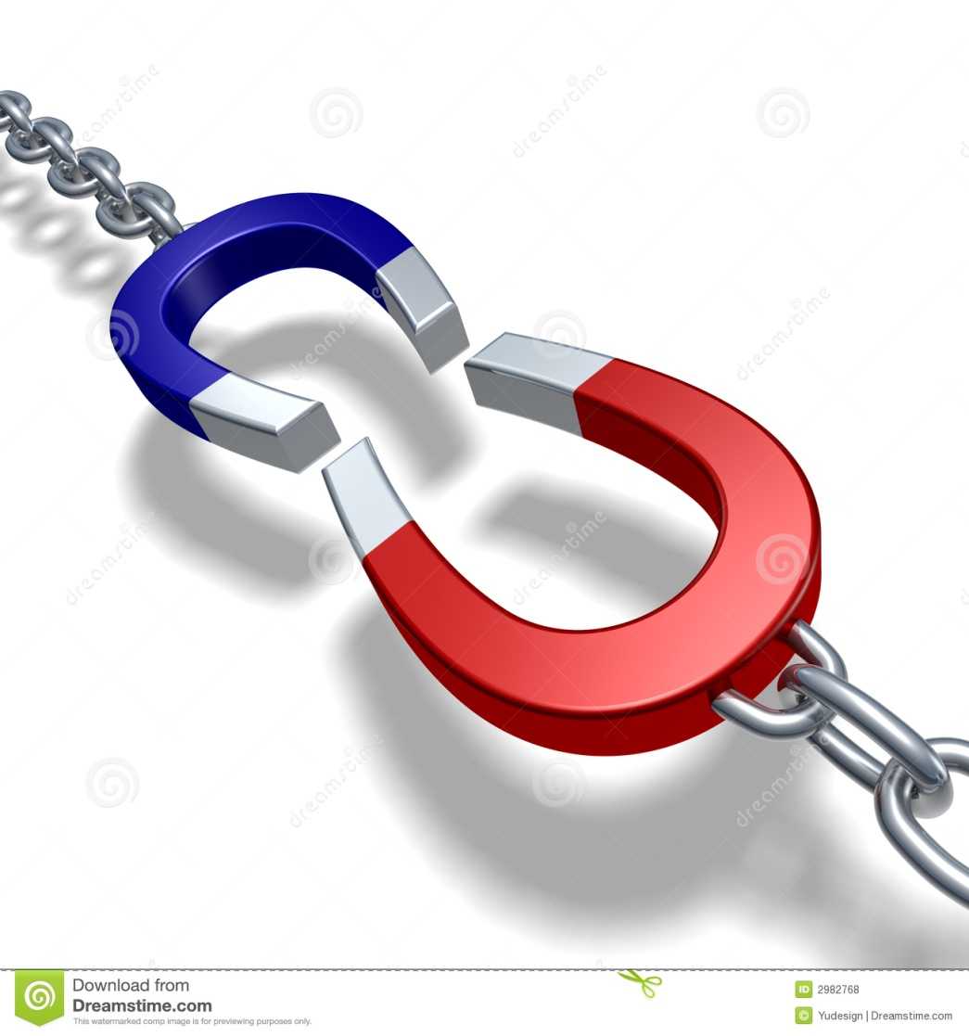
Example of Non-Contact Force
14. Magnetism

Slide 18
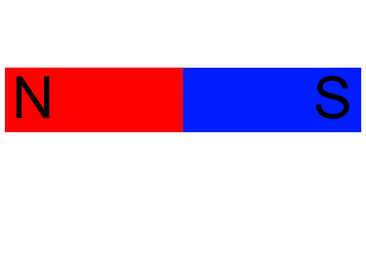
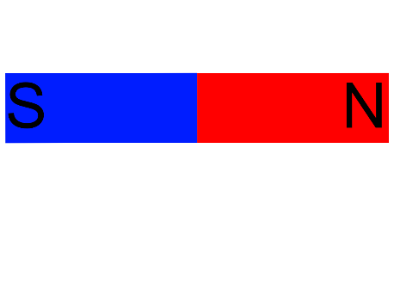
Non-contact forces Forces between objects that are not physically touching.
Magnetic force
When objects made from a magnetic material are in a magnetic field they experience a magnetic force.
Like magnetic poles (N – N or S – S) repel.
Unlike magnetic poles (N – S) attract.

Slide 19
Non-contact forces Forces between objects that are not physically touching.
Electrostatic force
When charged objects are in an electric field they experience an electrostatic force.
Unlike charges (- and +) attract each other
Like charges (+ and + or - and -) repel each other

Slide 20
Separate the forces below into two groups Contact and non-contact forces
Magnetic force
Gravitational force
Air resistance
Normal contact force
Friction
Tension
Electrostatic force

Slide 21
Separate the forces below into two groups Contact and non-contact forces
Non-contact forces
Contact forces
Magnetic force
Friction
Gravitational force
Air resistance
Electrostatic force
Tension
Normal contact force

Slide 22
Review Questions
1) What is meant by a contact force?
_____________________________________________ (1)
2) Name 3 examples of contact forces.
_____________________________________________ (3)

Slide 23
Answers
1) What is meant by a contact force?
Contact forces act when objects are physically touching.
(1)
2) Name 3 examples of contact forces.
Any 3 three friction, air resistance, tension, normal contact force (or reaction force). (3)

Slide 24
Review Questions
3) What is meant by a non-contact force?
_____________________________________________ (1)
4) Name 3 examples of non-contact forces.
_____________________________________________ (3)

Slide 25
Answers
3) What is meant by a non-contact force?
Non-contact forces can act when objects are physically separated.
(1)
4) Name 3 examples of non-contact forces.
Magnetic, gravitational and electrostatic forces. (3)

